Slide 1
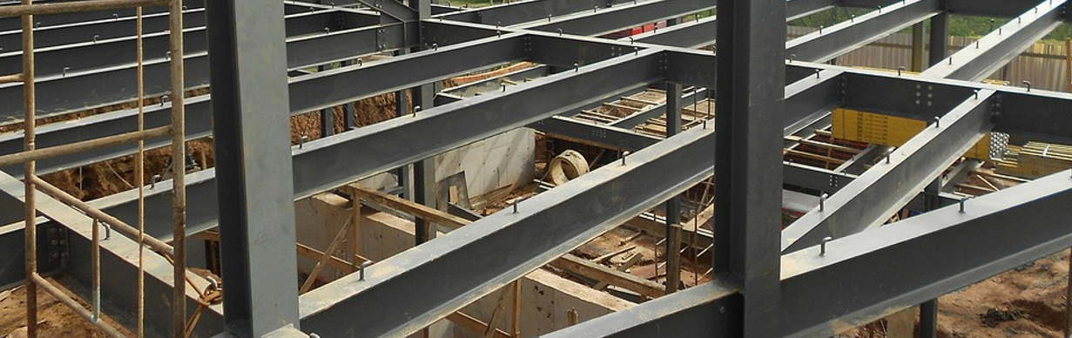
Displaying Shear force, Bending moment & Deflection diagram for Statically determinate beam using python
~ Mohammed Mahboob
CMR college of engineering and technology

Slide 2
Abstact
My focus in this project is to build an Application that analysis different forces on the statically determinate beams and shows the shear force diagram, bending moment diagram and also the deflection diagram.
The first step in the analysis of a beam is the determination of the reactions due to the different loads such as Point Loads, Uniformly Distributed Loads, Uniformly Varying Loads, Trapezoidal Loads and point Moments . Given the reactions, one can establish the internal forces using equilibrium-based procedures. Due to this unaligned forces pushing one part of a body in one specific direction, and another part of the body in the opposite appears on the body of the beam, also known as Shear Force. Bending moment is induced on the beam when the loads are placed at different distances with respect to a specific load.
At the end we are plotting shear force diagram, bending moment diagram and deflection diagram within few seconds.

Slide 3



Introduction
What are Statically Determinate Beams ?
If the reaction forces can be calculated using equilibrium equations alone, they are statically determinate. Which are ΣF =0 (Net Forces on the beam is Zero) and ΣM =0 (Net Moment on the beam is Zero).
They are further classified into:
Cantiliver Beam
A beam fixed only at one end, while the other end has no support.
Simply Supported Beam
A beam which is supported at the two ends of the beam
Overhang Beams
A beam that has one or both end portions extending beyond its supports

Slide 4
Literature review
Pramod [1]-The study was done to develop a software for minimum weight design of steel structures by using python programming. Plastic analysis was carried out for portal frames using the principal of kinematic theorem of minimum weight design. Graphical method of linear programming was used for optimization of weight. A single frame was considered and compared with manual calculations and concluded that software takes less time as compared to manual calculation.
J.M. Djokovice [2]- The load carrying capacity or limiting load at which the structure collapses is determined and presented a C++ program which computes the value of the load factor and determined whether the static distribution of the bending moment is safe, using method of plastic analysis. The program has the capability of generating the possible mechanisms of collapse visually

Slide 5
Requirements
Python Programming Lanuage,
Jupyter Notebook IDE and
Python libraires which are math, numpy and plotly

Slide 6
Methodology
User Input:
taking the values from the user such as span of beam, distance of support in case of overhang beam, point loads, point moments, uniformly distributed loads(UDL), uniformly varying loads(UVL), Trapezoidal distributed loads(TDL) and Flexual Rigidity(EI), initial rotation of the support at A,
Reaction Calculation
Creating a function for each different types of loads which is used to give vertical reaction at fixed end in case of cantilever beam and two reactions in case of simply supported and overhang beam then calling this function and summing up the values of reaction in a numpy array.

Slide 7
Shear Force Calculation
Creating a function which after calculating different value of shear force by a particular load on the beam stores then calling this function and summing up the values of reaction in a numpy array.
Bending Moment Calculation
Creating a function which after calculating different value of bending moment by a particular load on the beam stores then calling this function and summing up the values of reaction in a numpy array.
Calculation
Creating a function which after calculating different value of shear force by a particular load on the beam stores then calling this function and summing up the values of reaction in a numpy array.
Bending Moment Calculation
Creating a function which after calculating different value of bending moment by a particular load on the beam stores then calling this function and summing up the values of reaction in a numpy array.

Slide 8
Process
The first step is to divide the span of the beam into very small segments and collecting in an array
We are going to calculate the Shear Force and Bending Moment due the loads one at a time for each segment of the beam and doing performing the calculation for that particular load, then collecting the values of the shear force and moment in an array
For the next load it is again going to calculate the shear force and moment for each segment but while storing it in an array it is going to evaluate the result between the previous value and current value (e.g +7 is previous value and +2 is current value, therefore the result is +9 by superimposing it)
Deflection of the beam depends on the bending moment along all the sections of the beam. Since we don’t know the equation of the bending curve, therefore we are going to use Trapezoidal rule to integrate and find rotation followed by deflection
At the end we are going to plot by choosing the segment of the beam on X – Axis and the shear force , bending moment and Deflection on Y – Axis.

Slide 9
Point loads
x_{p}
90KN
A
Reaction Calculation
la_p = xp – A
_{mp = Fy*la_p}
_{la_b = B – A}
_{Vb = mp / la_b}
_{Va = 90 - Vb}
B
Va
Vb

Slide 10
Function to calculate the vertical reactions
Pl_record => stores vertical reactions due to each point load in an array format
If beam is subjected to any point load
1.
2.
This contains the formula showed in the previous slide which return vertical reactions to the called function
Iterating through all the point loads on the beam one by one
Calling the fuction at left hand side which returns the value of Reaction and storing it in two variables
Appending the values of the reaction in Pl_record row wise which is used for calculating shear force and bending moment
Adding the reaction obtained by point load in a reaction array

Slide 11
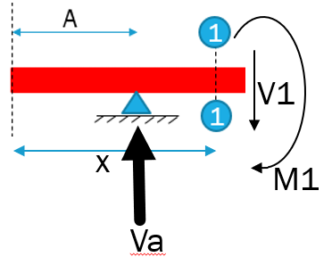
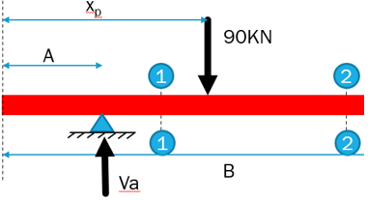
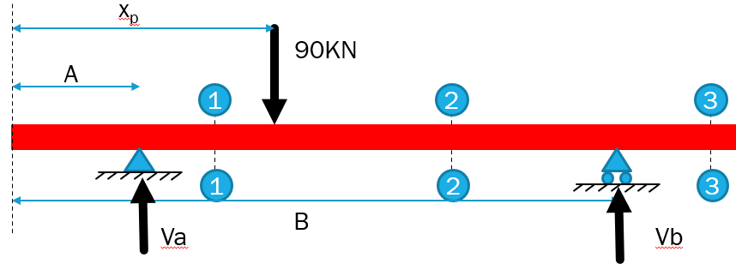
Shear Force and Bending Moment Calculation
Section 1-1:
V1 = Va
M1 = -Va*(x – A)
Section 2-2:
V1 = Va - 90
M2 = -Va*(x – A) – (-90)(x – xp)
Section 3-3:
V3 = Va – 90 + Vb
M3 = -Va*(x – A) –(-90)*(x – xp) – Vb*(x – B)
V2
M2
V3
M3

Slide 12
Function to calculate shear force and bending moment
If beam is subjected to any point load
Xp => location of point load
Fy => magnitude of point load
Va => Vertical Reaction at A due to that particular point load(i.e from Pl_record )
Vb => Vertical Reaction at A due to that particular point load(i.e from Pl_record )
Shear => array of length of span
Moment => array of length of span
Iterate through each value of length of span
Iterating through all the point loads on the beam one by one
Calling the function at left hand side and and returning the value of shear forces and moment in a container
Appending the value of shear forces in a shear force container array row wise
Appending the value of moment in a moment container array row wise
Calculation of shear forces and moments using the formula and logic on the previous slide
Adding the value of the shear and moment in Shear, Moment array in that particular index of length

Slide 13
Point moments
x_{m}
A
B
M
Reaction Calculation
ΣM _{A}=0
la_Vb = B – A = 0
M – Vb*(la_Vb) = 0
Vb =M / la_Vb
ΣF_{y} =0
Va = -Vb
Va
Vb

Slide 14
Function to calculate the vertical reactions
Pm_record => stores vertical reactions due to each point moment in an array format
If beam is subjected to any point moment
1.
2.
This contains the formula showed in the previous slide which return vertical reactions to the called function
Iterating through all the point loads on the beam one by one
Calling the fuction at left hand side which returns the value of Reaction and storing it in two variables
Appending the values of the reaction in PM_record row wise which is used for calculating shear force and bending moment
Adding the reaction obtained by point load in a reaction array

Slide 15
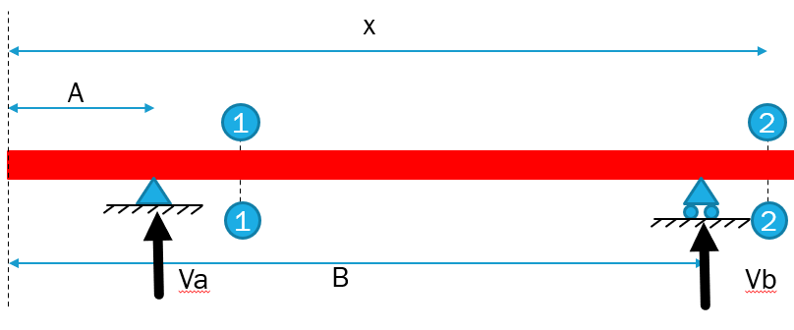
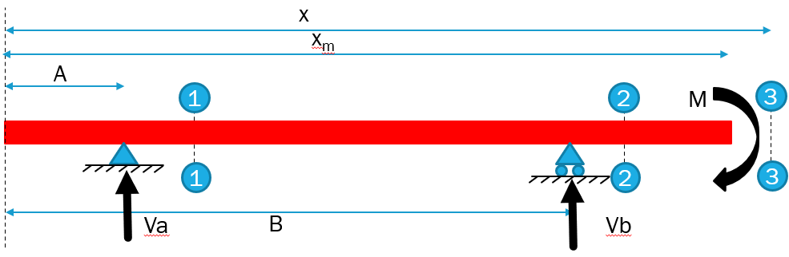
Shear Force and Bending Moment Calculation
Section 1-1:
V1 = Va
M1 = -Va*(x – A)
Section 2-2:
V2 = Va + Vb
M2 = -Va*(x – A) – Vb*(x - B)
Section 3-3:
V3 = Va + Vb
M3 = -Va*(x – A) – Vb*(x - B) - M
V2
M2

Slide 16
Function to calculate shear force and bending moment
If beam is subjected to any point moment
Xp => location of point load
Fy => magnitude of point load
Va => Vertical Reaction at A due to that particular point load(i.e from Pl_record )
Vb => Vertical Reaction at A due to that particular point load(i.e from Pl_record )
Shear => array of length of span
Moment => array of length of span
Iterate through each value of length of span
Iterating through all the point loads on the beam one by one
Calling the function at left hand side and and returning the value of shear forces and moment in a container
Appending the value of shear forces in a shear force container array row wise
Appending the value of moment in a moment container array row wise
Calculation of shear forces and moments using the formula and logic on the previous slide
Adding the value of the shear and moment in Shear, Moment array in that particular index of length

Slide 17
Uniformly distributed load
x_Res
Fy_Res
xStart
xEnd
Fy (KN/m)
A
Reaction Calculation
Fy_Res = Fy*(xEnd – xStart)
x_Res = xStart + 0.5*(xEnd – xStart)
la_p = A – x_Res
Mp = Fy_Res*la_p
La_vb = B – A
Vb = mp / la_vb
Va = - Fy_Res – Vb
B
Vb
Va

Slide 18
Shear Force and Bending Moment Calculation
Section 1-1 i.e when x lies between xStart and xEnd (xStart ≤ x ≤ xEnd)
Shear = Fy(x – xStart)
Moment = - Fy(x – xStart)*0.5*(x – xStart)
Section 2-2 i.e when x is greater than xEnd (x > xEnd)
Shear = Fy*(xEnd – xStart)
Moment = - Fy(xEnd – xStart)*
(x – xStart - 0.5*(xEnd - xStart))
1
xStart
x
1
xStart
2
xEnd
x
2

Slide 19
Varying distributed loads
x_Res
Fy_Res
xStart
xEnd
A
Fy (KN/m)
Reaction Calculation
Case A:
Fy_Res = 0.5*(fy_start)*(xEnd – xStart)
X_Res = xStart + 1/3 *(xEnd – xStart)
Case B:
Fy_Res = 0.5*(fy_End)*(xEnd – xStart)
X_Res = xStart + 2/3 *(xEnd – xStart)
la_p = A – x_Res
Mp = fy_Res*la_p
la_vb = B – A
Vb = mp / la_vb
Va = -Fy_Res - Vb
Va
B
Vb
Fy_Res
Fy_Res
x_Res
x_Res
Fy_Start
Fy_End
Case A
Case B

Slide 20
la_R1
R1
la_R2
Shear Force and Bending Moment Calculation
Case A ( |Fy_start|>0 )
Section 1-1 (xStart ≤ x ≤ xEnd)
X_Base = x – xStart
F_cut = Fy_start – xBase*(Fy_start/(xEnd - xStart))
R1 = 0.5*(xBase)*(Fy_start – Fcut)
la_R1 = 2/3 *(x_Base)
R2 = (xBase)*(Fcut)
la_R2 = 0.5 * (x_Base)
Section 2-2( x > xEnd )
R = 0.5*(xEnd - xStart)*(Fy_start)
la_R = x – xStart - 1/3 *(x_End – x_Start)
R2
1
Fy_start - Fcut
Fcut
X_Start
X_Base
1
x
la_R1
R
2
Fy_Start
X_Start
xEnd - xStart
x
2

Slide 21
R1
la_R
Case B ( |Fy_end|>0 )
Section 1-1 (xStart ≤ x ≤ xEnd)
X_Base = x – xStart
F_cut = xBase*(Fy_end/(xEnd - xStart))
R = 0.5*(xBase)*(Fcut)
la_R1 = 1/3 *(x_Base)
Section 2-2( x > xEnd )
R = 0.5*(xEnd - xStart)*(Fy_end)
la_R = x – xStart - 2/3 *(x_End – x_Start)
1
Fcut
X_Start
X_Base
1
x
la_R
R
2
Fy_end
xEnd - xStart
X_Start
x
2

Slide 22
Trapezoidal distribution load
X_Res
Fy_Res
A
Fy_Start
Fy_End
Reaction Calculation
Case A:
Fy_Res = 0.5*(fy_start + fy_end)*(xEnd – xStart)
X_Res = xStart + 1/3 *(((xEnd – xStart)*(fy_Start + (2*fy_End)))/(fy_start + fy_end)
Case B:
Fy_Res = 0.5*(fy_start + fy_End)*(xEnd – xStart)
X_Res = xStart + 1/3 *(((xEnd – xStart)*(fy_End + (2*fy_Start)))/(fy_start + fy_end
la_p = A – x_Res
Mp = fy_Res*la_p
la_vb = B – A
Vb = mp / la_vb
Va = -Fy_Res - Vb
Va
B
Vb
Case A
Case B
x_Res
Fy_Res
x_Res
Fy_Start
Fy_End
Fy_Start
Fy_End
xStart
xStart
xEnd
xEnd

Slide 23
la_R1
Shear Force and Bending Moment Calculation
Case A ( |Fy_start|>0 )
Section 1-1 (xStart ≤ x ≤ xEnd)
X_Base = x – xStart
F_cut = Fy_start – xBase*((Fy_start – Fy_end)/(xEnd - xStart))
R1 = 0.5*(xBase)*(Fy_start – Fcut)
la_R1 = 2/3 *(x_Base)
R2 = (xBase)*(Fcut)
la_R2 = 0.5 * (x_Base)
Section 2-2( x > xEnd )
R = 0.5*(xEnd - xStart)*(Fy_start + Fy_end)
la_R = xStart + (1/3)*(((xEnd-xStart)*(fy_start+2*fy_end))/(fy_start+fy_end))
R1
la_R2
1
R2
Fy_start
F_cut
xStart
X_Base
x
1
la_R
R
1
Fy_start
Fy_end
xStart
xEnd
x
1

Slide 24
la_R2
la_R1
Case B ( |Fy_end|>0 )
Section 1-1 (xStart ≤ x ≤ xEnd)
X_Base = x – xStart
F_cut = Fy_start + xBase*((Fy_end – Fy_start)/(xEnd - xStart))
R1 = 0.5*(xBase)*(Fcut – Fy_start)
la_R1 = 1/3 *(x_Base)
R2 = (x_base)*(Fcut)
la_R2 = 1/2 * xBase
Section 2-2( x > xEnd )
R=0.5*(xEnd-xStart)*(fy_end+fy_start)
la_R = xStart + (1/3)*(((xEnd-xStart)*(fy_start+2*fy_end))/(fy_start+fy_end))
R2
1
R1
Fy_start
F_cut
xStart
X_Base
x
1
2
la_R
R
Fy_start
Fy_end
xStart
xEnd
x
2

Slide 25
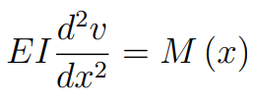

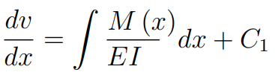
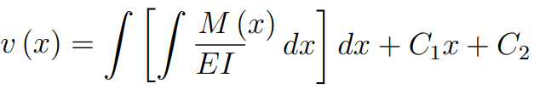
Deflection of beams using Numerical approach
Our goal is to integrate the moment equation:
In practice we integrate it in the form:
The first integration will give us the slope:
with C1 as the constant of integration
The second integration gives us the displacement:
where C2 is another constant of integration
C1 and C2 can be solved by using the boundary conditions

Slide 26
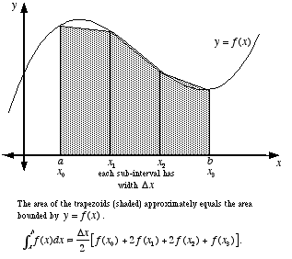
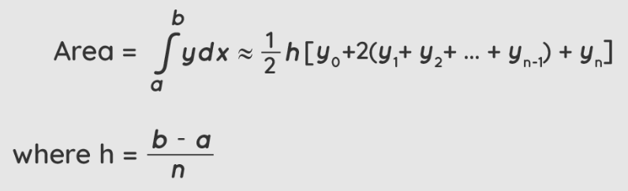
In this case we do not have an equation that describes the moment curve but we do have the value of the Moment (M) along the curve at each segment(each interval) of the length of beam (x)
In order to obtain the area under the curve we are going to use the Trapezoidal Rule
The formula is give as:

Slide 27
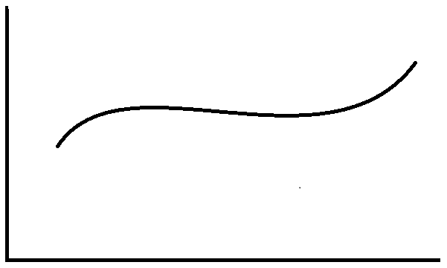


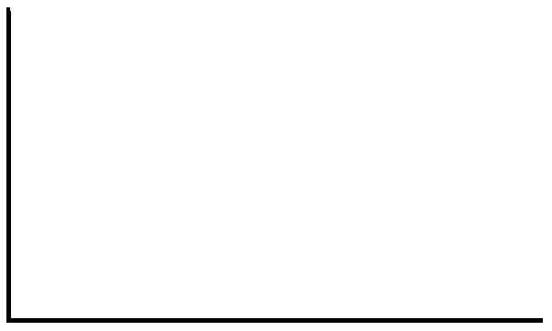

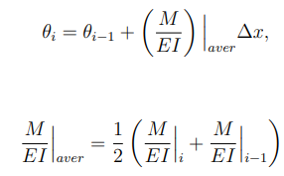



Deflection calculation process
M_{n} /EI
M₂/EI
M₃/EI
M₄/EI
M_{n-2} /EI
M_{n-1} /EI
M₁/EI
M₀/EI
x₀
x₁
x₂
x₃
x₄
x_{n-2}
x_{n-1}
{
x_{n}
X value of beam
Trapezoidal rule
θ₁
θ₂
θ₃
θ₄
Need to guess and correct if it is wrong
θ₀
Generalized Equation
Where,
x₀
x₁
x₂
x₃
x₄
X value of beam
This point lies on the support, therefore (y₀ = 0)
y₀
Generalized Equation
X value of beam
y₁
y₂
y₃
y₄

Slide 28
Θ₀ is the guess value here and y₀ is zero since it lies on the the left support of the beam
The deflections found in this manner depend on our guess for θ0 and will need to be corrected (unless we guessed the exact value).
If the right end of the support (x = xn) actually has a zero deflection, but our calculated value is not zero, say y ≠ 0, then we need to correct all the deflections by adding the correction term:
If the deflection is negative at the right hand support that means our guessed value Θ₀ is more than the exact value, therefore we need to reduce the value of Θ₀ by small amount and try again and again until the deflection is just positive
If the deflection is positive at the right hand support that means our guessed value Θ₀ is less than the exact value, therefore we need to increase the value of Θ₀ by small amount and try again and again until the deflection is just negative
Therefore it is an iterative process to find the correct value of Θ₀
Θ₀
Error

Slide 29
Plotting and printing
To plot the Shear Force Diagram, Bending Moment Diagram and Deflection diagram we are going to plot the relationship between the segment of the span of beam in X-Axis vs the shear force, bending moment, deflection in Y-Axis (X and Y values are collected in numpy array)
i.e for each index of the span of beam (x) there is going to be a shear force and bending moment

Slide 30
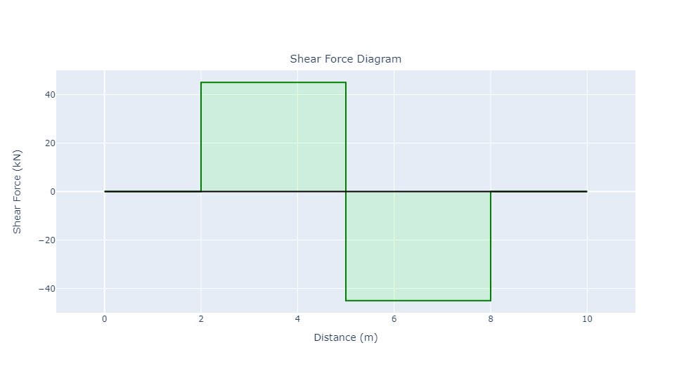

Slide 31
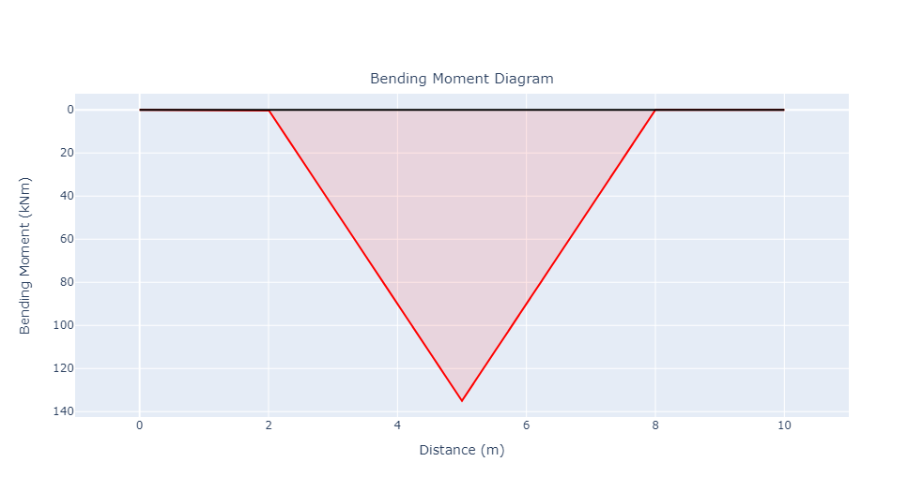

Slide 32
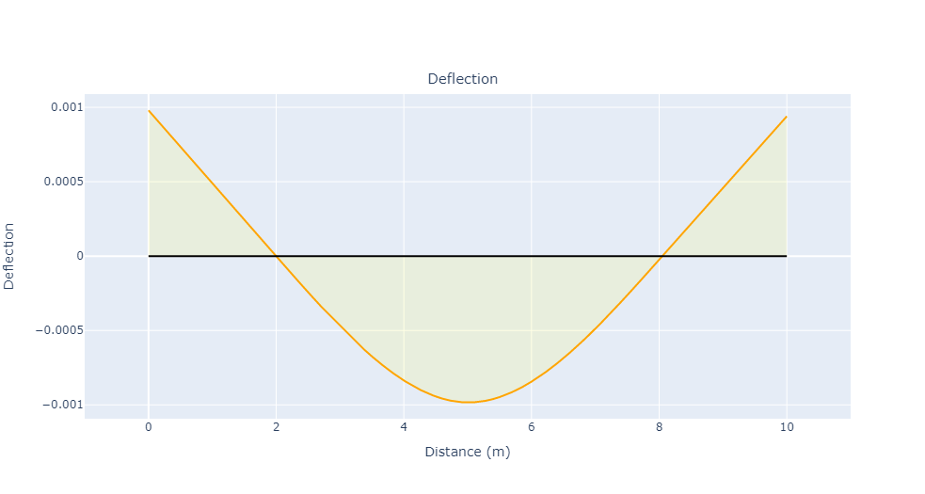

Slide 33
conclusion
The end result of this project is that it displays a SFD, BMD & Deflection Diagram on a graphical format, when the mouse cursor is hover over the curve, it displays the value of span and value of shear force or bending moment or deflection at that particular index

